Slide 1
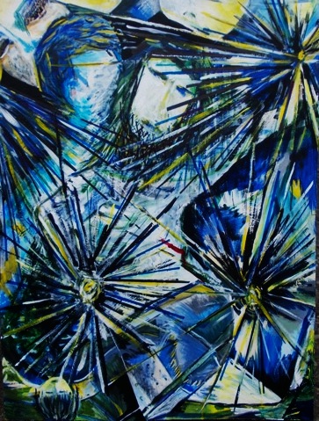
Wesley Methodist Church
Stations of the Cross
10am – 12noon
Mon.10th April
- Sat. 15th April
Good Friday
9am - 4pm
Mon.10th April
-Thur. 13th April
6 - 8pm
A. Briant 2015
You are invited to reflect on a series
of Original Artworks by Anne Briant
that allow you to engage with the emotions and feelings experienced on the Journey to the Cross.

